Slide 1
Assignment No.01
Linux Introduction and basic commands.
Name:Naikade Rohit Anand

Slide 2
1.Print a system information and linux server release name.
Uname command is used to get system information in linux.if you use uname only,it will print kernel name of your system.
Common flags include:
Uname -n:prints network hostname.
Uname -v:prints kernel version.
Uname -r:prints kernel release.
Uname -m:prints your machine hardware name.
Lsb_release -a command is used to print current ubantu version running on your system.
Notes:
‹#›

Slide 3
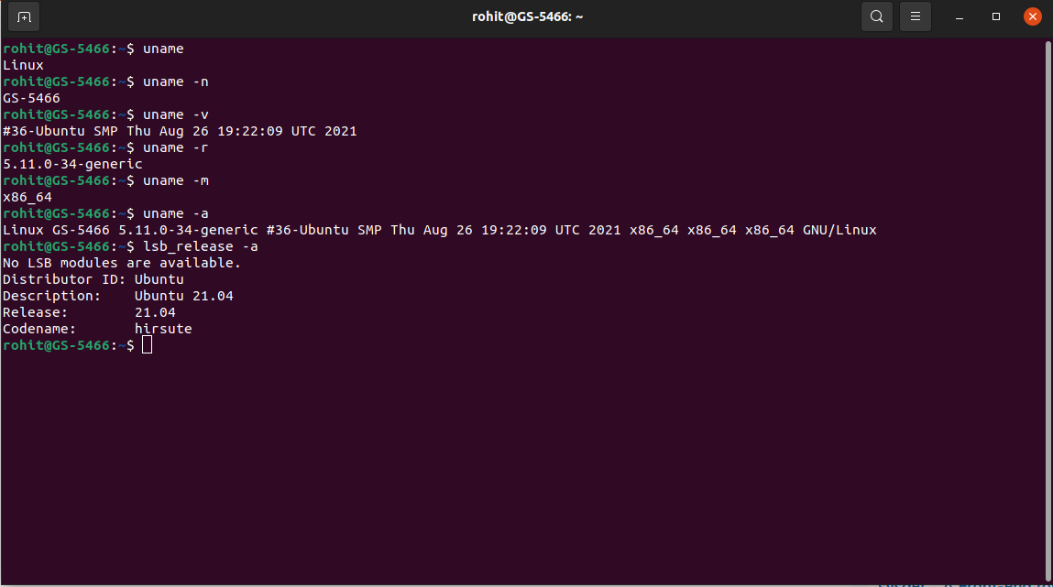

Slide 4
2.Display username with which you are logged in.
There are four commands to get info about currently logged in user:
1.whoami:prints user name who is currently logged in.
2.who:prints current logged in user with logged in time.
3.w:print current logged in users with what they are doing.
4.id:prints current logged in user’s user id and group in information.
Notes:
‹#›

Slide 5
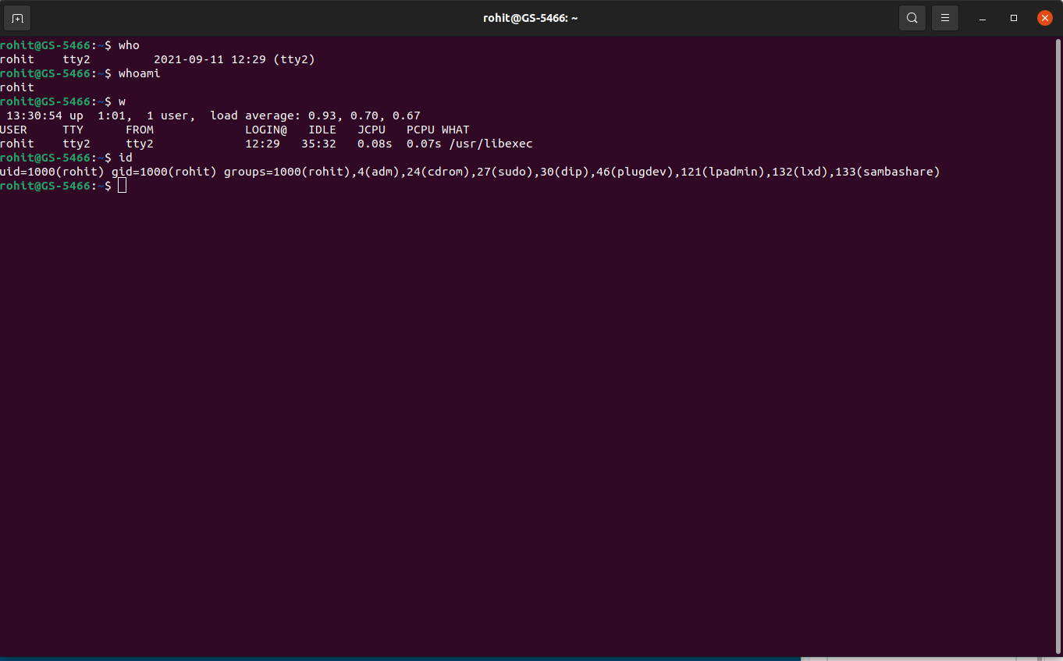

Slide 6
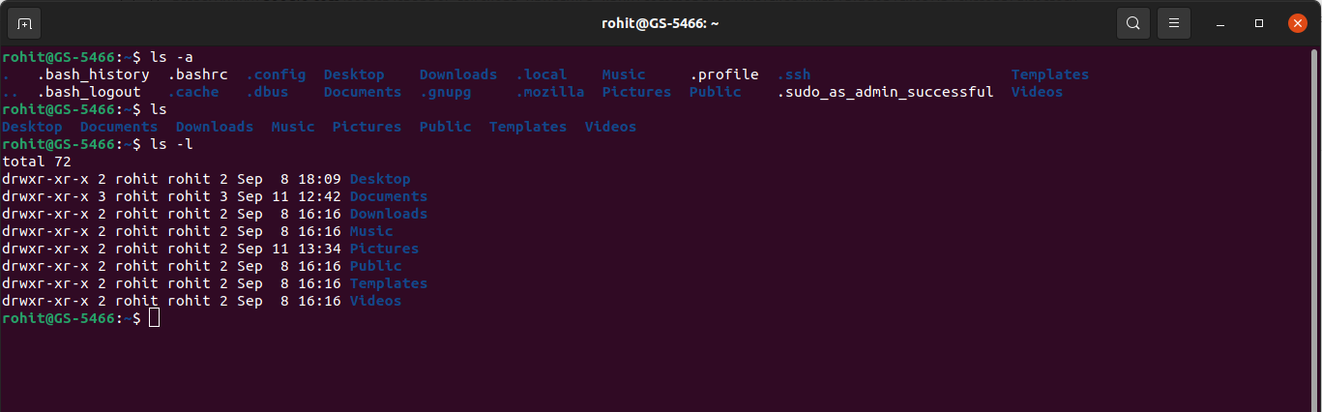
3.List all the files (including hidden files) in your home directory.
Ls command is used to list all files in a current directory.-l option provides additional information about files.
To show hidden files in a current directory,-a option is used.
Notes:
‹#›

Slide 7
4.List the files in /boot in a human readable format.
Firstly,move to /boot using cd command.
To print list of files in human readable format,use -h option
Notes:
‹#›

Slide 8
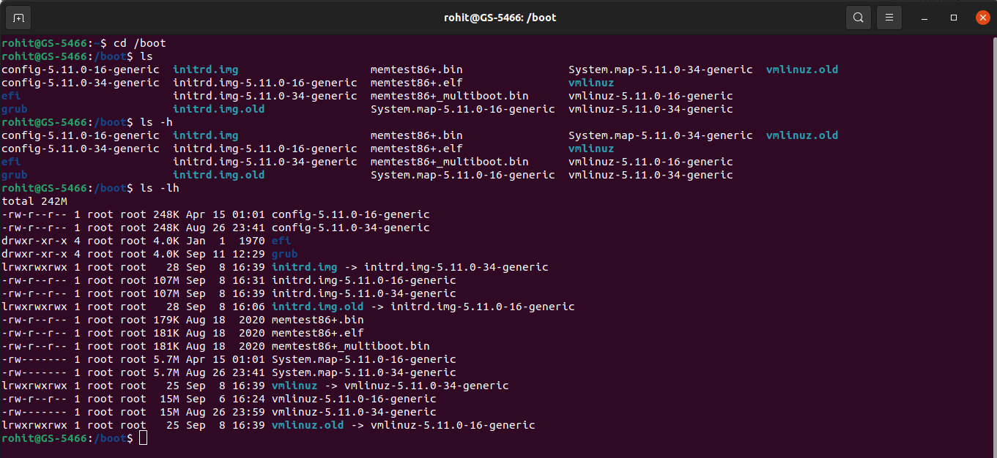

Slide 9
5.Display the first 12 lines of /etc/services.
Head command is used to print first few lines from a specified file.
If you want to print n lines specifically,mention -n in command.
Ex:head -12 /etc/services
Notes:
‹#›

Slide 10
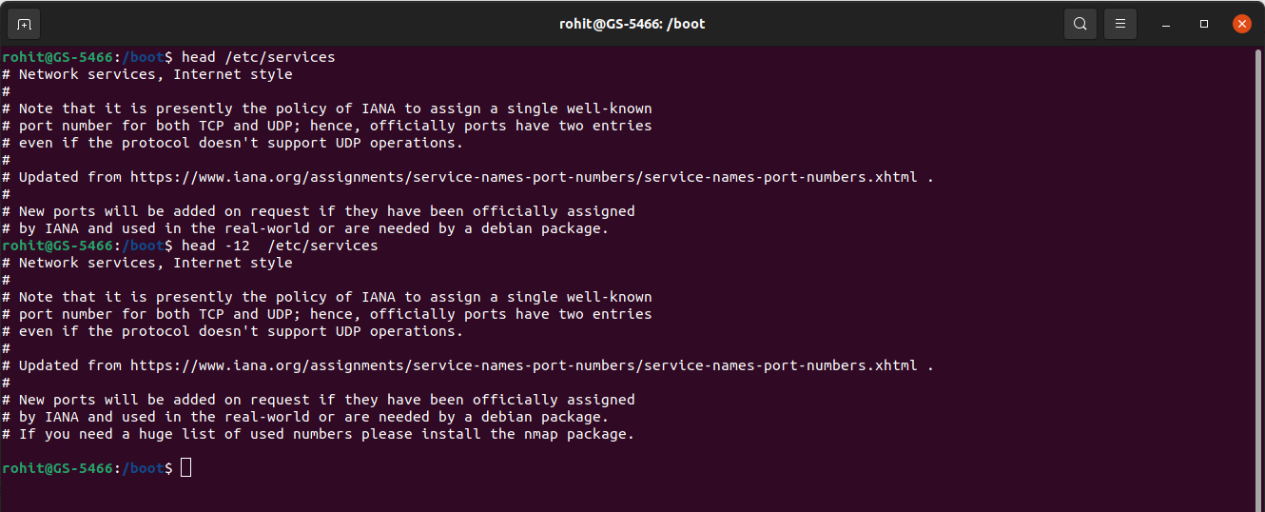

Slide 11
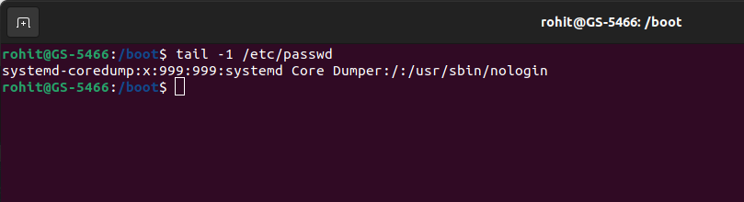
6.Display the last line of /etc/passwd
Tail command is used to print last few lines from a specified file.
To print n lines specifically,mention -n in command.
Ex:tail -1 /etc/passwd
Notes:
‹#›

Slide 12
7. List the partition types and print the partition table.
Lsblk command is used to print partition table of the system.
Fdisk command returns list of partitions.
Notes:
‹#›

Slide 13
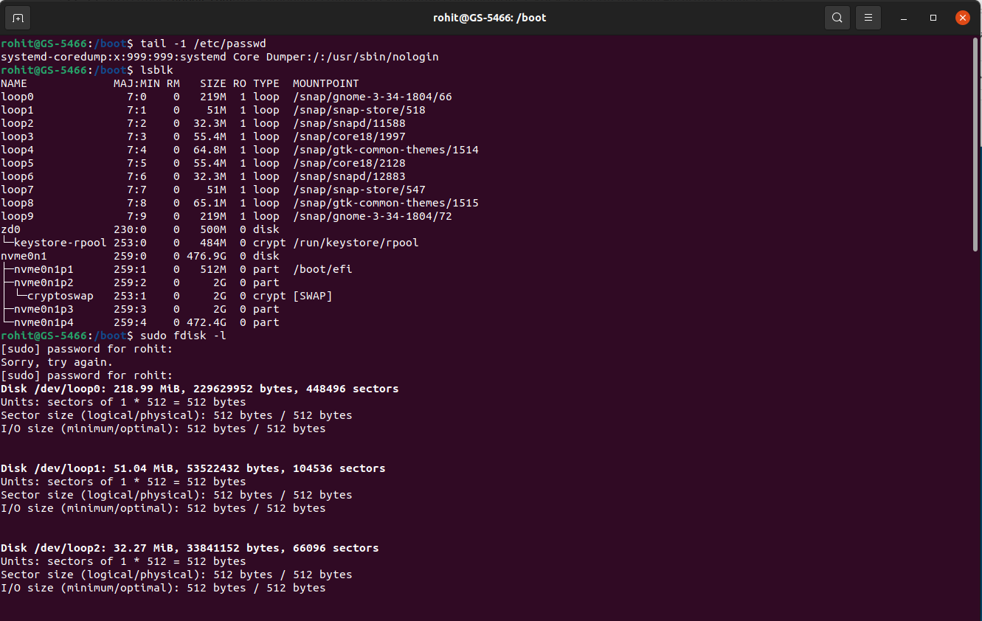

Slide 14
8. Create a new group. Create a new user along with specifying a password for it. Add this new user to the new group created and print these details for verification.
Sudo usermod command is used to add user in an existing group.-a -G flags are used in command.
Syntax:sudo usermod -a -G groupname username.
Options:
-a:add user in a group.
-G:specifies the name of secondary group name in which we want to add an user.
Notes:
‹#›

Slide 15
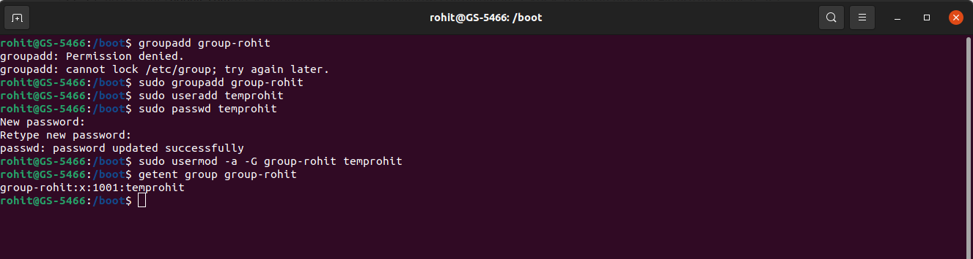

Slide 16
9. Locate the daemons running on the system.
A daemon is a long-running process which answers requests for services.
To print currently running daemons,use command service --status-all.
Notes:
‹#›

Slide 17
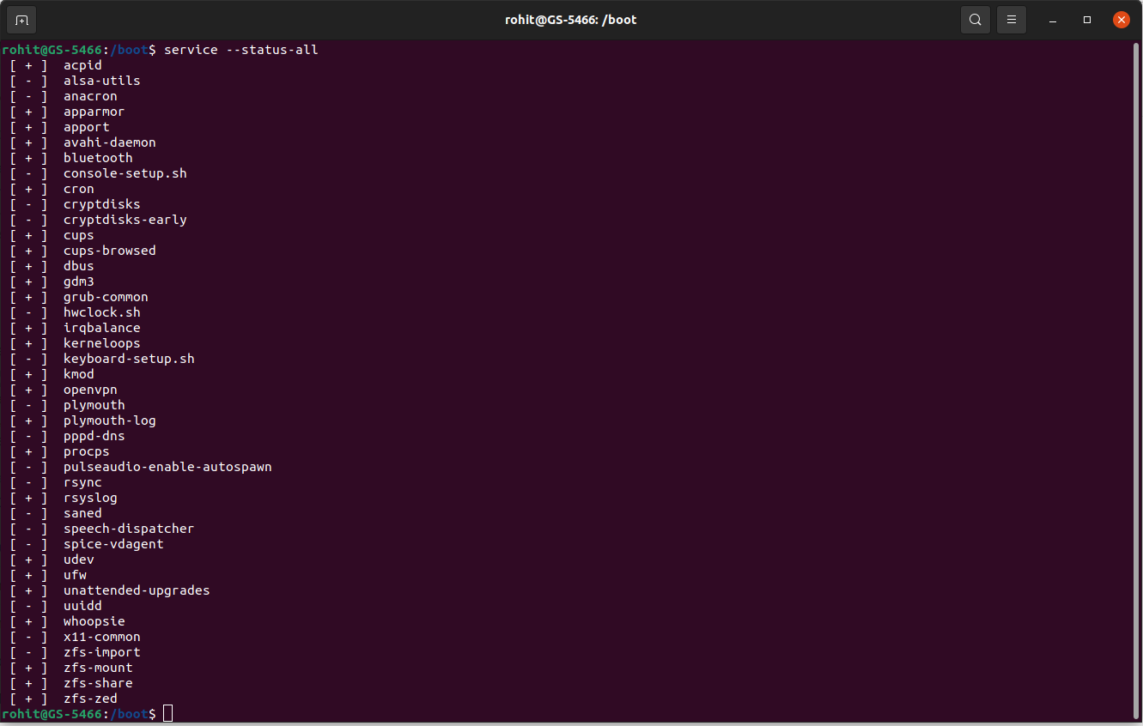

Slide 18
10.Display A B C with two spaces between B and C.
For this statement,use echo command to print desired output.
Ex:echo “A B C”
Notes:
‹#›

Slide 19
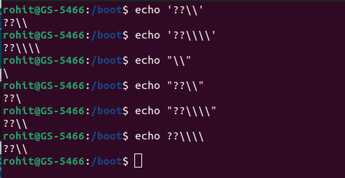
11. Use echo to display the following exactly:??\\
Notes:
‹#›

Slide 20
12.Write a command that executes rm file55. Your command line should print 'success' if file55 is removed, and print 'failed' if there was a problem.
This statement checks knowledge of piping in linux.here use rm command to delete file.use and operator to print decisions.
If file deleted successfully,echo “success” else print “failed”.
Notes:
‹#›

Slide 21
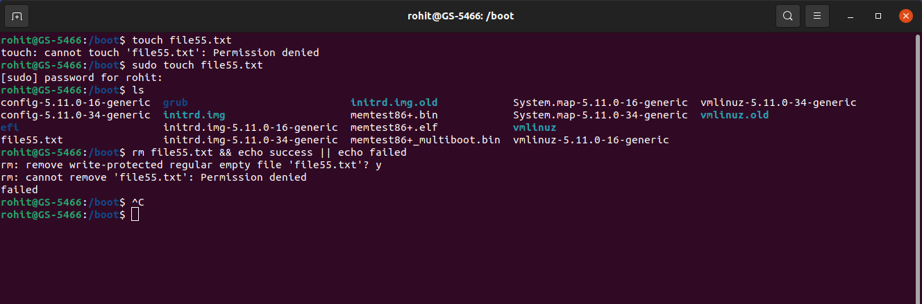

Slide 22
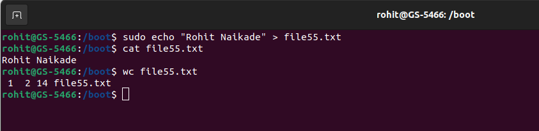
13.Create a script which takes ‘String’ type input from user and prints the number of lines, words and characters in it. Any input other than ‘String’ type, should result in an error.
Wc command is used to count lines,words and characters in an specified file.
It prints lineCount,wordCount and character count and file name.
Notes:
‹#›

Slide 23
14.Create a file with 10-15 lines of text and perform the following operations-
a. Replaces first occurrence of the with THE on every line of the file.
b. Replaces every occurrence of & (escaped) with "and"
c. Put a # at the beginning of lines 5 through 10
d. Do a "grep'' to find lines containing the word ‘a', then delete them
Notes:
‹#›

Slide 24
14.Create a file with 10-15 lines of text and perform the following operations-
a. Replaces first occurrence of the with THE on every line of the file.
b. Replaces every occurrence of & (escaped) with "and"
c. Put a # at the beginning of lines 5 through 10
d. Do a "grep'' to find lines containing the word ‘a', then delete them
Notes:
‹#›

Slide 25
a.Replaces first occurrence of the with THE on every line of the file
Sed utility provides facility to replace contents of file.
Options:
1)-i:perform in-place changes in a file.
2)g:perform changes in whole file instead of replacing first occurrence.
Syntax: sudo sed -i ‘s/old_owrd/new_word/’ filename
Notes:
‹#›

Slide 26
b.Replaces every occurrence of & (escaped) with "and".
Sed utility provides facility to replace contents of file.
Options:
1)-i:perform in-place changes in a file.
2)g:perform changes in whole file instead of replacing first occurrence.
Syntax: sudo sed -i ‘s/old_owrd/new_word/’ filename
Notes:
‹#›

Slide 27
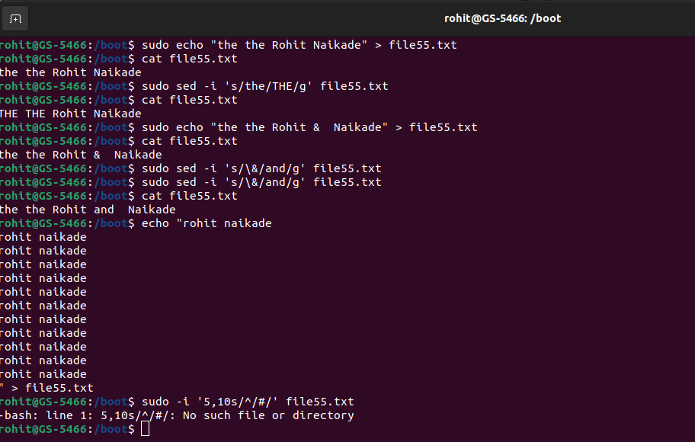

Slide 28
c.Put a # at the beginning of lines 5 through 10.
Sed utility provides facility to add contents in the start or end of the line of file.
Syntax:
Sudo sed -i ‘start,end s/^/<addContent>/’ filename
Notes:
‹#›

Slide 29
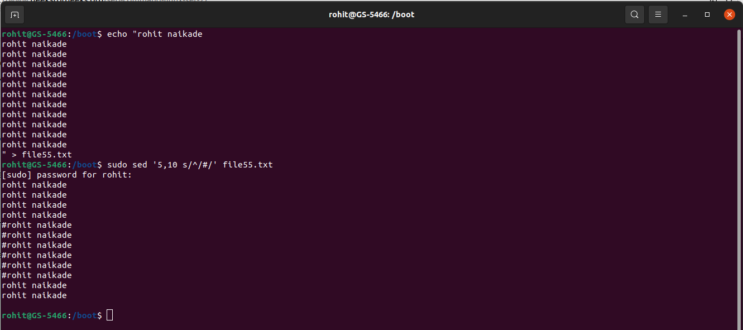

Slide 30
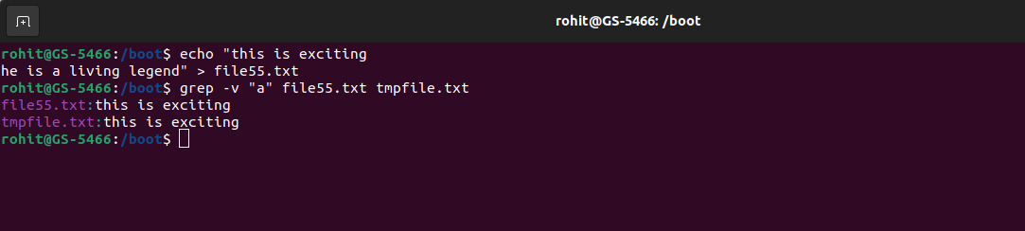
d. Do a "grep'' to find lines containing the word ‘a', then delete them.
Grep command provides facility to find words in a file.-v option of grep provide facility to exclude lines which contains matched words.
Syntax:grep -v “matchingWord” srcFile destFile
Notes:
‹#›

Slide 31
15. Install a libvirt/python package on your machine.
Apt-get package manager is used to install packages in linux.
Notes:
‹#›

Slide 32
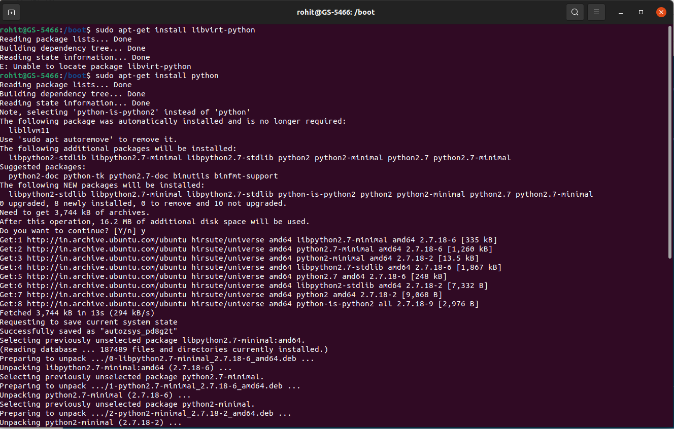

Slide 33
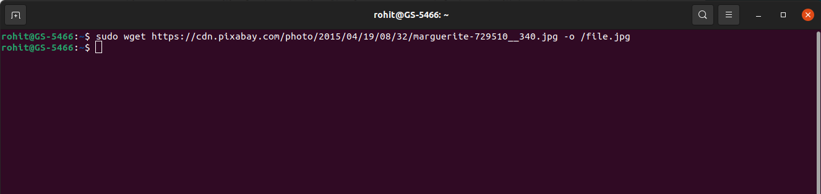
16. Download the file using command line:
Wget command provides functionality to download file from specified URL.
Syntax:wget <url> -o <localapth>
Notes:
‹#›

Slide 34
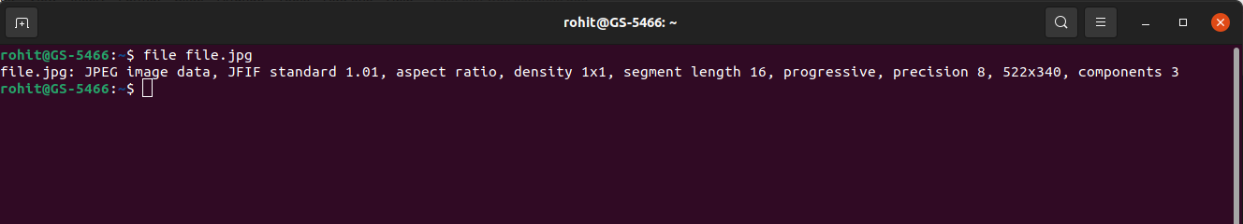
17.Display the type of file.
File command of linux provides facility to determine type of specified file.
Syntax:file filename
Notes:
‹#›

Slide 35
18.You receive information that one of your servers was cracked, the cracker probably replaced the
ls command. You know that the echo command is safe to use. Can echo replace ls ? How can
you list the files in the current directory with echo ?
Notes:
‹#›

Slide 36
This problem can be resolved by shell script.we can loop through file names in a file and print them using echo command.
For entry in ‘$boot’/*
Do
Echo “$entry”
done
Notes:
‹#›

Slide 37
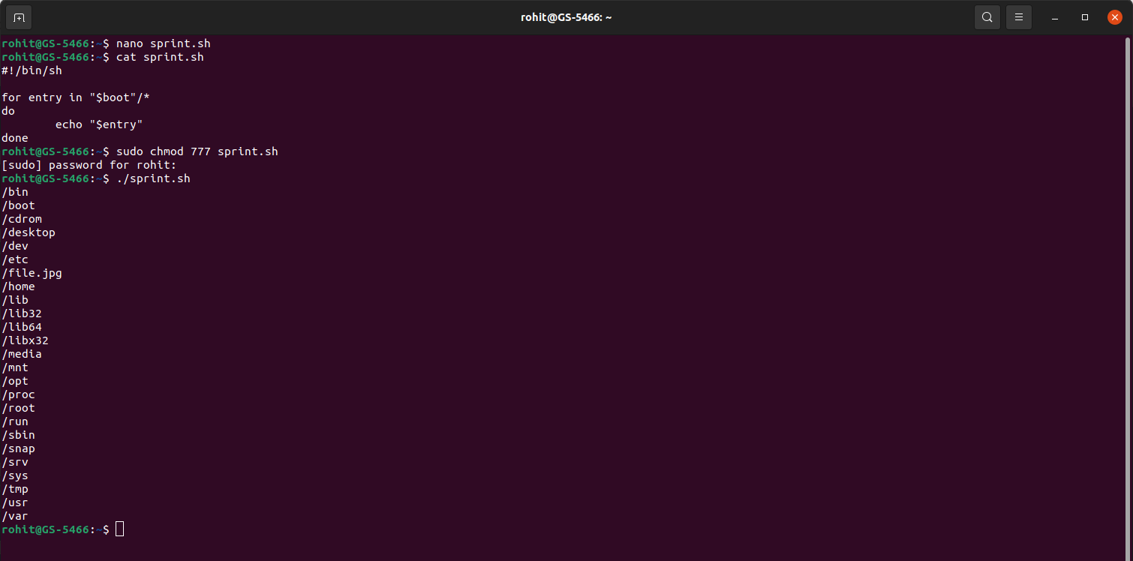

Slide 38
19.Put a sorted list of all bash users in bashusers.txt.
To accomplish this task,firstly get currently logged in users using w command and store it into bashusers.txt file.
Then,sort file contents using sort filename command.
Ex:w > bashusers.txt
Sort bashusers.txt
Notes:
‹#›

Slide 39
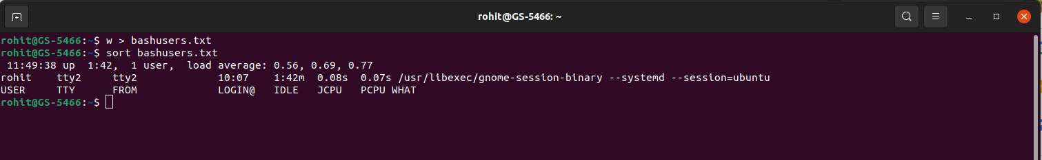

Slide 40
20.Look at the output of /sbin/ifconfig. Write a line that displays only ip address and the subnet mask.
Here,grep command will be handy.firstly read content from file and using pipe operator,use grep command to filter output.
ex:/sbin/ifconfig | grep -w “inet”
Notes:
‹#›

Slide 41

Thank You

